Slide 1
Settlor Intent: The Cardinal Rule is No Red Herring
Delaware Trust Conference 2025
Todd A. Flubacher – Morris Nichols Arsht & Tunnell LLP
Vincent C. Thomas – Young Conaway Stargatt & Taylor LLP
Beth Gansen Knight – Richards, Layton & Finger, P.A.
October 28, 2025 | Wilmington, Delaware

Slide 2
Overview
• Delaware’s trust law and the centrality of settlor intent
• Statutory provisions reinforcing settlor intent
• Key Delaware cases tracing the "cardinal rule"

Slide 3
Section 3303 – Enforceability Statute
• Maximum effect to freedom of disposition and the enforceability of governing instruments
• Allows broad enforceability unless willful misconduct standard of care or public policy violated
• Settlor assurance that terms will be respected as written

Slide 4
Pre-Mortem Validation (Sections 3546, 1311, 1312)
• Trusts, Wills, and Powers of Appointment
Allows early validation of trusts, wills, and powers of appointment
• 120-day limitation after providing statutory notice to contest
Provisions for deemed sending, presumption of receipt, and virtual representation
• Codifies Ravet v. Northern Trust Co. and related notice principles

Slide 5
Section 3329 – No-Contest Clauses
• Enforceable in Delaware discouraging frivolous litigation
Limitations: actions by trustee or personal representative, prevailing beneficiaries, settlement of dispute, action to determine whether a proceeding constitutes a contest, or for action for construction or interpretation

Slide 6
Section 3303 – Charitable Trust Enforcement
• Allows settlor or designee to enforce charitable trust purpose
• Extends standing beyond Attorney General’s office
• Strengthens settlor oversight of charitable legacy

Slide 7
Purpose Trusts (Sections 3555 & 3556)
• Permits non-charitable purpose trusts for any purpose not impossible of attainment
• 2025 amendments define "enforcer" and its fiduciary status
Ability to vest exclusive standing in the enforcer (other person)
• Enforcer placed on par with trustees and advisers under Title 12
Clarification of distributions in furtherance of the purpose

Slide 8
Letters of Wishes (Sections 3301 & 3315)
• Codified in 2024; defines ‘letter of wishes’ as any separate, non-binding writing
• Trustee discretion whether to consider such letters under abuse of discretion standard
• Delivered to the trustee by trustor or on trustor’s behalf; reflects intent contemporaneous with trust creation; not inconsistent with the governing instrument

Slide 9
Case Law: The 'Cardinal Rule'
• "Settlor’s intent controls" – cornerstone of Delaware trust law
• Originated from will cases (Bird v. Wilmington Soc. of Fine Arts, 1945)
• Adapted to trust interpretation through subsequent cases (Annan v. Wilmington Tr. Co., 1989)

Slide 10
Bishop v. McNeil, 1999 WL 743489 (1999)
• In exercising discretion, Trustees must carry out settlor’s intent
• Post-hoc extrinsic evidence rejected when terms unambiguous
• Court adhered strictly to governing instrument and contemporaneous intent

Slide 11
In re Trust Under Will of Flint for Benefit of Shadek, 118 A.3d 182 (2015)
• Court denied modification of a trust and establishes a new test for the judicial modification of trusts requiring consideration of settlor intent
• Beneficiaries cannot rewrite trust contrary to settlor intent

Slide 12
Bird v. Wilmington Soc. of Fine Arts, 28 Del.Ch. 449 (1945).
• Thorough discussion of will construction principals, holding all rules serve only to ascertain testator intent
• Intention expressed with words in the instrument read in light of circumstances at execution
• Extrinsic evidence cannot override an unambiguous instrument nor used to infer intent not discernible from the language and circumstances

Slide 13
Chavin v. PNC Bank, 816 A.2d 781 (2003)
• Reiterated "settlor’s intent controls" as the cardinal rule
• Intent determined by instrument language in its entirety and creation context
• All other rules of construction are subordinate aids to settlor intent

Slide 14
In re Peierls Family Inter Vivos Trusts, 59 A.3d 471 (2012) and In re Peierls Family Inter Vivos Trusts, 77 A.3d 249 (2013).
• Explored settlor intent in choice-of-law and administrative situs changes
• Supreme Court overturns Delaware Chancery Court when analyzing settlor intent
• Trust instrument may implicitly authorize a change in the law governing the administration of the trust

Slide 15
Otto v. Gore, 45 A.3d 120 (2012)
• Party seeking to prove a trust must demonstrate intent to create a trust
• Extrinsic and intrinsic evidence are admissible to determine whether the requisite intent existed at trust creation, but not to interpret unambiguous terms
• Court found that the settlors did not intend to finalize a prior instrument as a trust (despite their signatures) based on lack of follow-through and their consistent formal practices for actual trusts

Slide 16
Annan v. Wilmington Trust Co., 559 A.2d 1289 (1989)
• Affirmed the general rule that settlor intent controls interpretation
• Used extrinsic evidence only when ambiguity existed
• Settlor’s intention for a particular law to govern through a choice of law provision will be respected

Slide 17
Raymond L. Hammond Irrevocable Trust Agreement, 2016 WL 359088 (2016).
• Reiterated that settlor’s intent at the time the trust is established governs interpretation
• Extrinsic evidence excluded when language is unambiguous
• Power of appointment subject to specified formalities, those formalities substitute for inquiry into intent
Post creation intent or extrinsic evidence not considered when formalities unfulfilled

Slide 18
Dickinson v. Wilmington Trust Co., 734 A.2d 605 (1999)
• Court considered whether certain testamentary powers of appointment were general in nature
• Intent of the donor is the controlling factor
• Based upon an unambiguous trust instrument, Court found that the powers of appointment were general

Slide 19
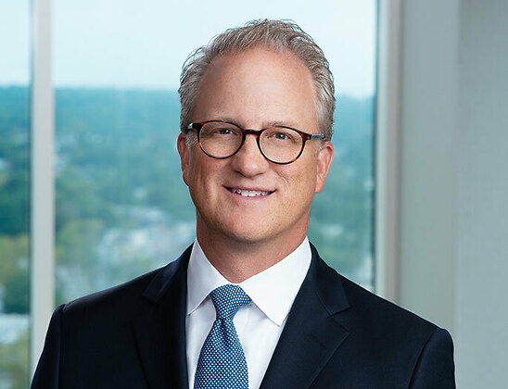
Works with national, international and local clients on the creation, migration, modification and administration of Delaware trusts.
Todd A. Flubacher is a Partner in Morris Nichols’ Trusts & Estates Group. He is a Fellow of the American College of Trust and Estate Counsel (ACTEC) and is a member of the Trust Administration Committee (Past Chair) and Fiduciary Litigation Committee, and he is Delaware State Chair-Elect. He holds the designation of Accredited Estate Planner® (AEP®) by the National Association of Estate Planners & Councils (NAEPC) and was inducted into the NAEPC Estate Planning Hall of Fame in 2023.
Todd Flubacher represents Delaware trustees, beneficiaries, law firms and individuals throughout the country on all matters involving Delaware trusts and estates. His practice primarily emphasizes the unique advantages of Delaware trust law, including dynasty trusts, directed trusts, asset protection trusts, trust modifications, and tax planning. Todd also represents trustees, executors, and beneficiaries in all types of trusts and estates litigation and has served as an expert witness in litigation involving Delaware trusts.
Todd Flubacher graduated with a J.D. from University of Maryland School of Law, with honors, in 1999. He graduated summa cum laude from Drexel University in 1992 with a B.S., finance. He is admitted to practice before the Courts of the State of Delaware and the U.S. District Court for the District of Delaware.
Todd A. Flubacher
(302) 351.9374
tflubacher@morrisnichols.com

Slide 20
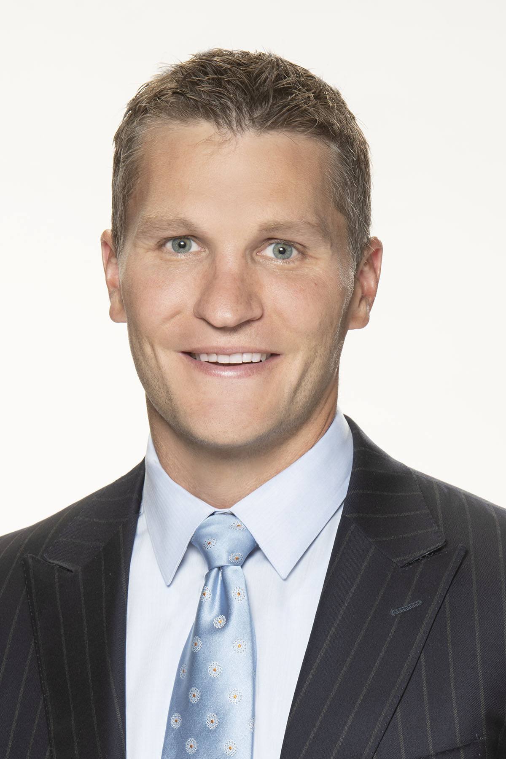
Nationally recognized for his expertise in trust and estate planning, trust-owned business planning, and complex tax structuring
20 years of experience and ongoing representation of billionaire and high-net-worth clients
Vincent C. Thomas is a Partner in and Co-chair of Young Conaway Stargatt & Taylor, LLP’s Business Planning and Tax Section. He is a Fellow of the American College of Trust and Estate Counsel (ACTEC) and served as a law clerk to Chief Justice Myron Steele of the Delaware Supreme Court and as a Wolcott Fellow for the Delaware Court of Chancery.
When closely-held companies, high net worth individuals, and family offices seek help in structuring transactions around tax, liability, business succession, and other corporate issues, they call on Vince to combine sophisticated counsel with sound and practical business judgment. His transactional skills, often in collaboration with the firm's other sections, are a unique and valuable complement to his long-established practice representing institutional trustees and individuals in issues of Delaware trust and alternative entity law.
Vince Thomas earned an undergraduate degree in Accounting from the University of Delaware, his J.D. degree, magna cum laude, from Widener University Delaware Law School, and his L.L.M. in Tax from Villanova University Charles Widger School of Law. He is admitted to the practice of law in Delaware.
Vincent C. Thomas
(302) 576.3278
vthomas@ycst.com

Slide 21
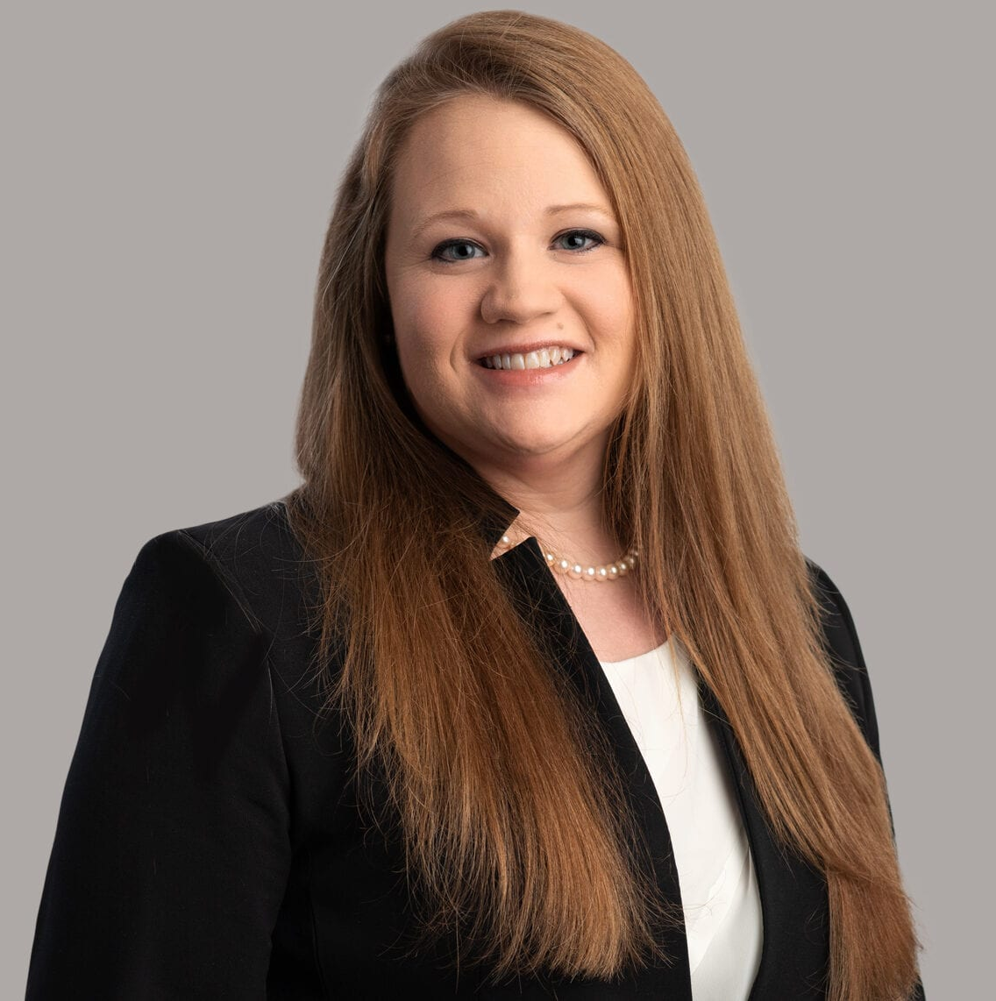
Beth Gansen Knight practices primarily in the areas of estate planning, estate administration, tax-exempt organizations and the formation and management of family planning vehicles and closely held businesses.
Ms. Knight is a past vice chairman and secretary of the Delaware Bar Association Section of Taxation, a member of Trust Act Committee of the Delaware Bar Association Estates and Trusts Section, and a member of the Estate Planning Council of Delaware, Inc.
Ms. Knight has been recognized in Chambers HNW (since 2018), The Best Lawyers in America (since 2019) and Delaware Today (since 2021). She has spoken on estates, trusts, and other tax-related topics in a variety of venues, including the Delaware Tax Institute, the Delaware Bankers Association Trust Conference and the Notre Dame Tax & Estate Planning Institute.
Ms. Knight received her B.A. degree, summa cum laude with honors, from the University of Northern Iowa, her J.D. degree, with high honors, from the University of Iowa College of Law, and her LL.M. degree in Taxation from Villanova University Charles Widger School of Law.
Beth Gansen Knight
(302) 651.7779
bknight@rlf.com

Slide 22
Disclaimer
This material is for general informational purposes only. It is not intended as professional, legal, accounting, or tax advice, and any such intention or advice is expressly disclaimed. The application and impact of laws can vary widely based on the specific facts involved or may change, and you should consult directly with your legal, accounting, or tax adviser with respect to your particular inquiries and needs.
Neither Young Conaway Stargatt & Taylor, LLP, nor any attorney or author is responsible for any errors or omissions contained in this material. All information is provided “as is,” with no guarantee of completeness, accuracy, or timeliness, and without warranty of any kind, express or implied. In no event will Young Conaway Stargatt & Taylor, LLP, its attorneys, or authors be liable to you or anyone else for any decision made or action taken in reliance on any information in this material or for any consequential, special, or similar damages, even if advised of the possibility of such damages. This material does not reflect the opinions of Young Conaway Stargatt & Taylor, LLP.
Circular 230 Disclosure: To comply with U.S. Treasury Regulations, any information contained in this material is not intended or written to be used, and cannot be used, by the recipient or any other person for the purpose of (1) avoiding penalties or any other restrictions that may be imposed under the Internal Revenue Code (IRC) or any other applicable tax law, or (2) promoting, marketing, or recommending to another party any transaction, arrangement, or other matter in violation of the IRC or any other applicable law or regulation.
© 2025 Young Conaway Stargatt & Taylor, LLP. All rights reserved.

